Slide 1
Android game development
The laboratory work 10

Slide 2
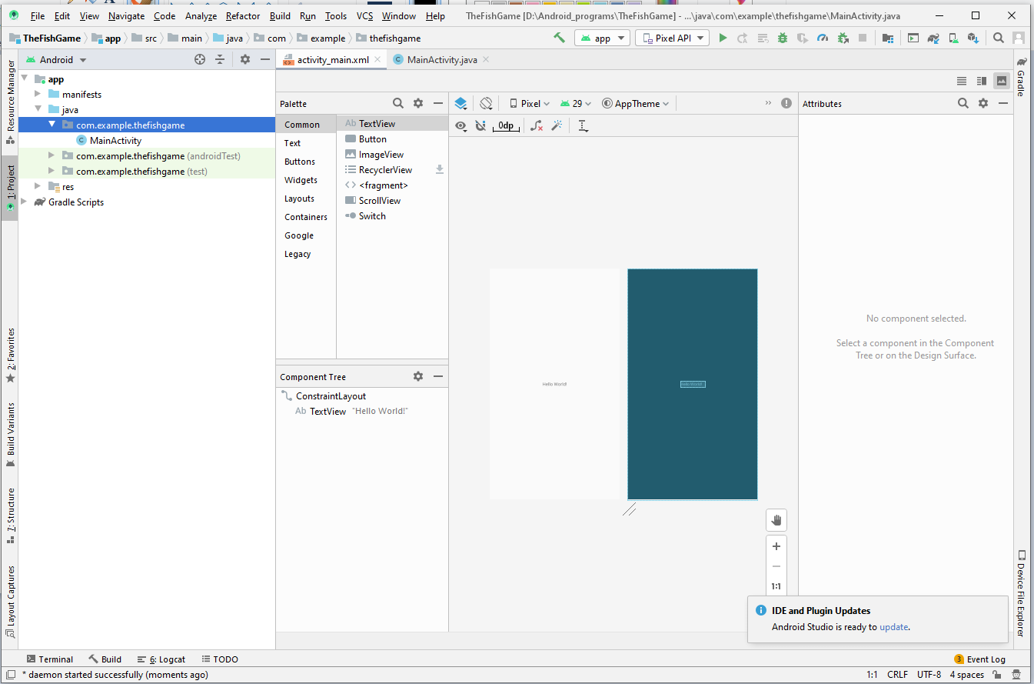
New android application
We create a new Android application

Slide 3
Changing styles
We change the style of the application by editing styles.xml file
<resources> <!-- Base application theme. --> <style name="AppTheme" parent="Theme.AppCompat.Light.NoActionBar"> <!-- Customize your theme here. --> <item name="colorPrimary">@color/colorPrimary</item> <item name="colorPrimaryDark">@color/colorPrimaryDark</item> <item name="colorAccent">@color/colorAccent</item> </style> </resources>

Slide 4
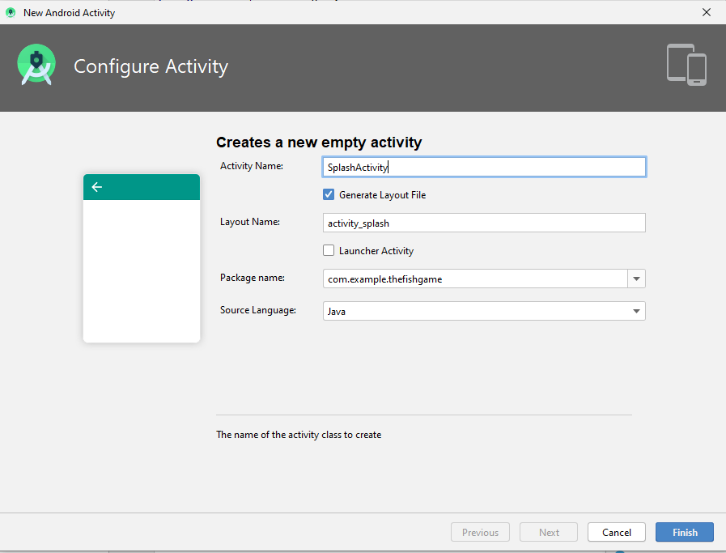
Splash screen
Creating a new empty Activity

Slide 5
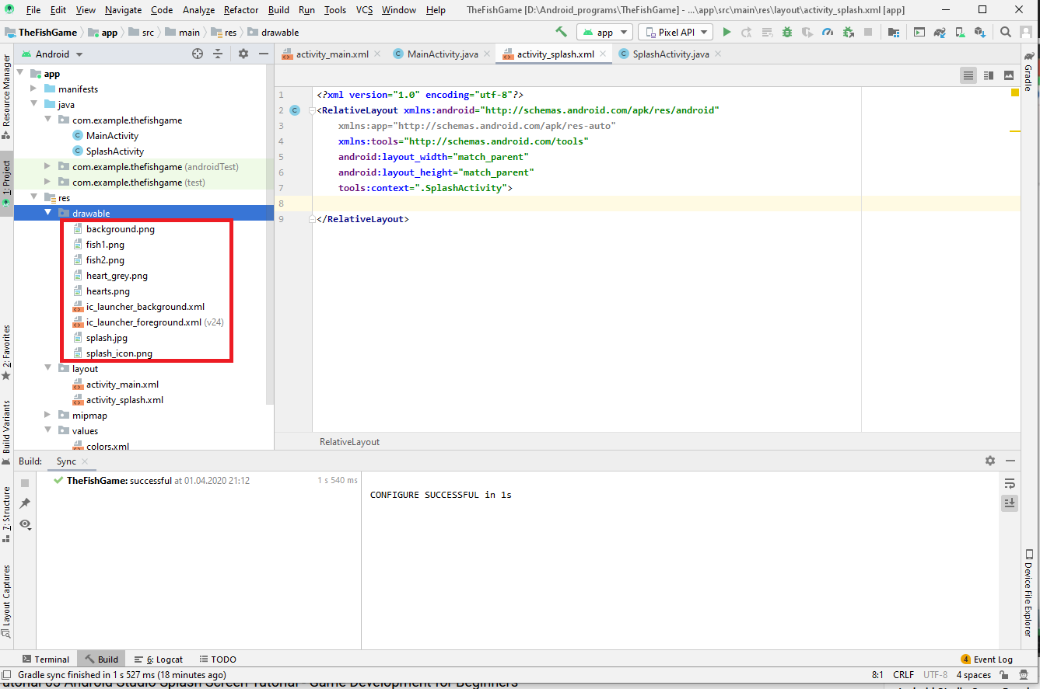
Adding icons
We need to download icons in the drawable folder of our Android application

Slide 6
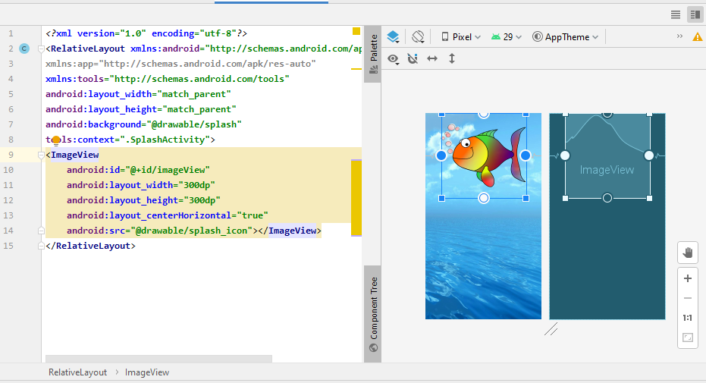
Images and background
We set a background of our application and put an icon on it.
<RelativeLayout xmlns:android="http://schemas.android.com/apk/res/android" xmlns:app="http://schemas.android.com/apk/res-auto" xmlns:tools="http://schemas.android.com/tools" android:layout_width="match_parent" android:layout_height="match_parent" android:background="@drawable/splash" tools:context=".SplashActivity"> <ImageView android:id="@+id/imageView" android:layout_width="300dp" android:layout_height="300dp" android:layout_centerHorizontal="true" android:src="@drawable/splash_icon"></ImageView> </RelativeLayout>

Slide 7
Editing splash screen

Slide 8
Students’ assignment
Create a new vide game application
Add a new activity screen where you can locate texts and images on the main windows
Run the application in emulator and look how it displays

